Slide 1
CAR 163916771 Finding
Please note that for milestones requiring updated SOPs, two things are required: (1) a copy of the updated version of the document attached to the milestone (pdf, Word document, etc.), (2) evidence showing that the document has indeed been updated and published (email from doc control, screenshot of current DCS screen, etc.)
A link to the DCS document will not be helpful if someone looks at the CAR in a year and it has been updated since the CAR milestone closed.

Slide 2

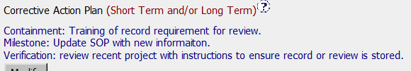
163916771
Explain how/If the nonconformity is fully addressed in the analysis – Mark
Focused upon issue cited in nonconformity
Does not address why records were not maintained
Did not address if record needs to be added to for project cited or any other affected projects
Why?
Correction needed?
Explain how/If the analysis supports the root cause statement – Kathy
Root cause is not complete – What situation and why wasn’t he aware of it? Why did the project coordinator not save the e-mail as a record?

Slide 3
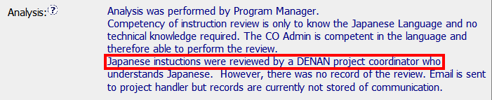
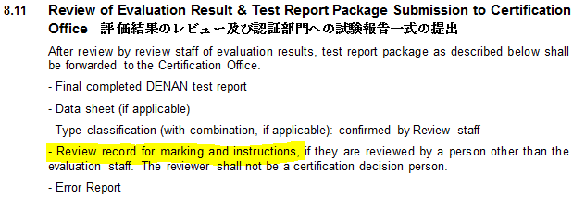
163916771
Explain how/If the analysis supports the Scope of Nonconformance statement - Gunsimar
Analysis supports:
- The program audit was DENAN
- However, should review of other projects have been part of analysis?
Explain why/If the Corrective Action Plan will prevent the recurrence of the nonconformity – Jenni
When the Coordinator is out?
Does the SOP revision clearly explain the new process?

Slide 4
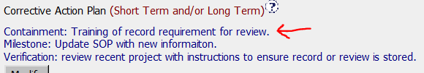
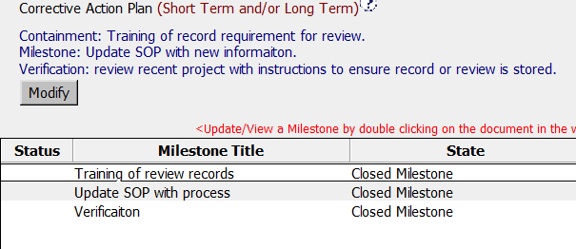
163916771
Explain how/If the containment milestone “stopped the bleeding” – Mark
Training will “stop the bleeding” as the SOP is being updated in a later milestone.
Fixing impacted records was not addressed as applicable or not applicable.
Confirm that/If all corrective action milestones are aligned to each item of the corrective action plan – Kathy
Yes, the corrective action milestones are aligned to each item of the CAP. There is a one to one match.

Slide 5
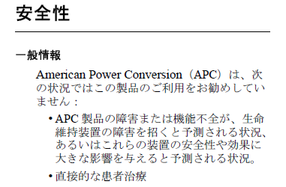
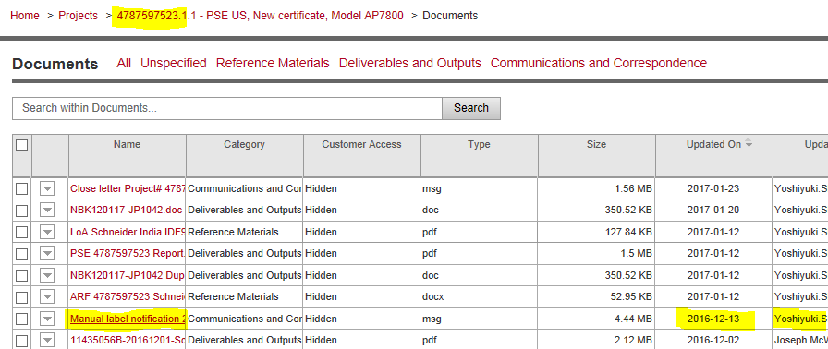
163916771
Explain how/If the verification milestone confirmed the effective implementation of the corrective action plan – Gunsimar
Verification was effective:
1. Project Coordinator reviewed Japanese marking and instructions and emailed PH.
2. Record of the email stored in FLEX.
3. Should more than one project have been checked? Later?

Slide 6
Agenda
CAR 163916356 (finding)
CAR 163916771 (finding)
CAR 163916507 (observation)

Slide 7
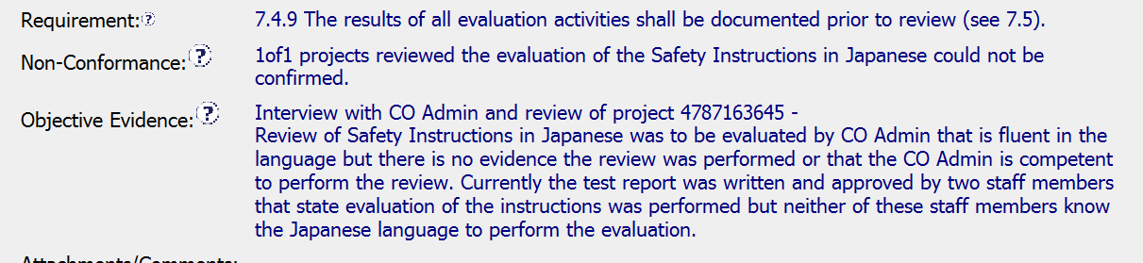
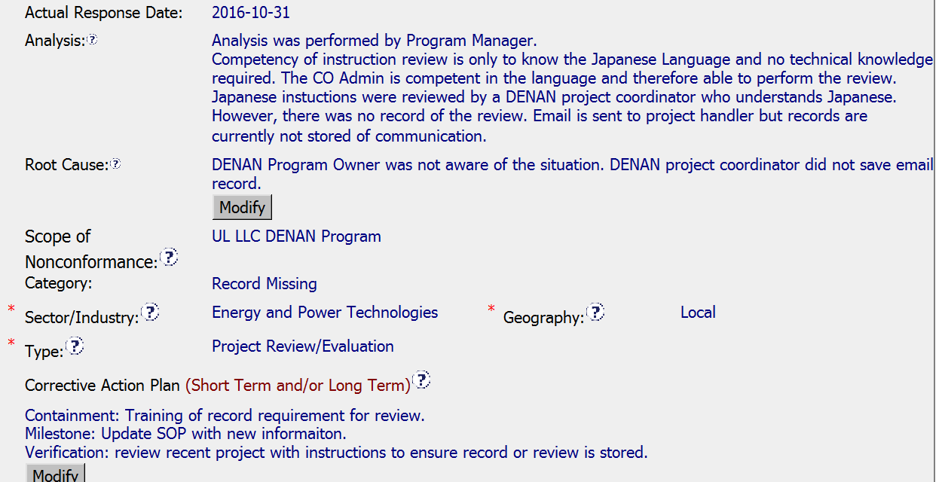
CAR 163916771

Slide 8
CAR 163916771
Q: Is the nonconformity fully addressed in the analysis?
A: Partially. Whether or not the SOP included requirements for storage and maintenance of these emails as records was not discussed in the analysis, and was a key element, the team believed.
Q: Does the analysis support the root cause statement?
A: Fully. Although neither addresses the maintenance of records SOP requirement, they are consistent with each other

Slide 9
CAR 163916771
Q: Does the analysis support the Scope of Nonconformance statement?
A: Fully. Scope is DENAN program and analysis addresses issue within context of the DENAN program. There is no reason to believe any other programs are involved.
Q: Will the Corrective Action Plan prevent recurrence of the nonconformity?
A: Fully. The analysis does not mention the need to better define quality records to be kept, the SOP revision did in fact define these to be maintained as part of the report package. It is reasonable to expect this will prevent future recurrences

Slide 10
CAR 163916771
Q: Did the containment milestone “stop the bleeding”?
A: Fully. Training provided immediately addressed ongoing projects
Q: Are corrective action milestones aligned to each item of the corrective action plan?
A: Fully. One to one correlation. Well matched.
Q: Did the verification milestone confirm the effective implementation of the corrective action plan?
A: Partially. The email provided as objective evidence was sent prior to the implementation of the corrective action. While the ability to provide this email helps to demonstrate that emails are being maintained, evidence which can be reliably demonstrated as being reflective of the effectiveness of the corrective action after implementation should have been produced.

